Slide 1
Topic: Non Linear Moving Parabolas

Slide 2
Contents
Glossary or Formula Page
Page
Date
Description
2
3

Slide 3
Tasks
24
7
30
Essential Question
Questions
Notes
Summary
4
5

Slide 4
24
7
30
Date
Non-Linear Geometry
Moving Parabolas
What happens when we move Parabolas Vertically?
5

Slide 5
24
7
30
Date
Non-Linear Geometry
Moving Parabolas
What happens when we move Parabolas Vertically?
The graphs below are of y =x ² - 2 y = x² = and y = x² + 2 .
5

Slide 6
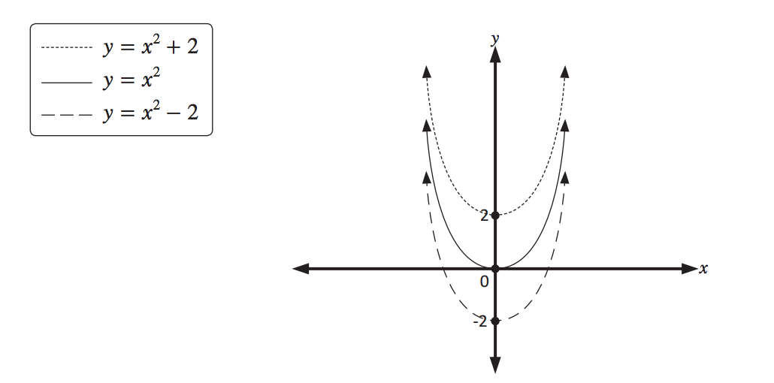
24
7
30
Date
Non-Linear Geometry
Moving Parabolas
What happens when we move Parabolas Vertically?
The graphs below are of y =x ² - 2 y = x² = and y = x² + 2 .
5

Slide 7
24
7
30
Date
Non-Linear Geometry
Moving Parabolas
What happens when we move Parabolas Vertically?
The graphs below are of y =x ² - 2 y = x² = and y = x² + 2 .
Adding units to a parabola shifts it up,
5

Slide 8
24
7
30
Date
Non-Linear Geometry
Moving Parabolas
What happens when we move Parabolas Vertically?
The graphs below are of y =x ² - 2 y = x² = and y = x² + 2 .
Adding units to a parabola shifts it up,
and
subtracting units from a parabola shifts it down.
5

Slide 9
24
7
30
Date
Non-Linear Geometry
Moving Parabolas
What happens when we move Parabolas Horizontally?
5

Slide 10
24
7
30
Date
Non-Linear Geometry
Moving Parabolas
What happens when we move Parabolas Horizontally?
5

Slide 11
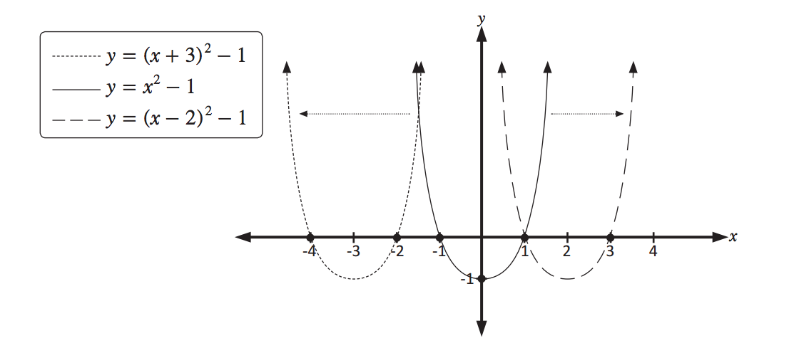
24
7
30
Date
Non-Linear Geometry
Moving Parabolas
What happens when we move Parabolas Horizontally?
5

Slide 12
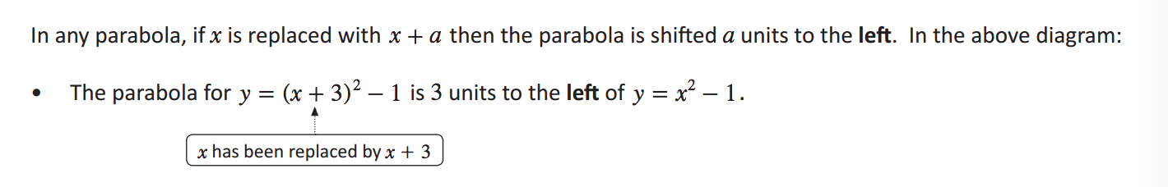
24
7
30
Date
Non-Linear Geometry
Moving Parabolas
What happens when we move Parabolas Horizontally?
5

Slide 13
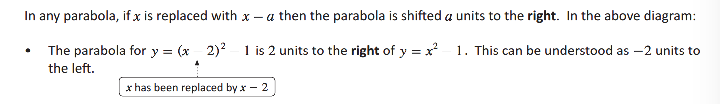
24
7
30
Date
Non-Linear Geometry
Moving Parabolas
5

Slide 14
Notes Review
24, 7 ,30
Date
Title
Essential question
Notes complete
Notes complete with colour and diagrams
Questions completed
Contents page filed in
Formula page filled in

Slide 15
Homework
Review your notes and write a summary answering the essential question.

